Slide 1
How We Got Here and Where We Are Now
April 2023

Slide 2
Content
Slide 3
Southwark Stands Together (SST) Inception
Slide 4
SST Aims
Slide 5
The Objective of SST Workforce
Slide 6
The Council’s Response with it’s Workforce
Slide 7 – 8
The Eight Workforce Workstreams
Slide 9
What we’ve done
Slide 10
What we still have to do

Slide 3
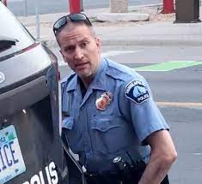
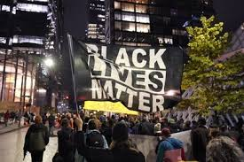
Southwark Stands Together (SST) – The Inception
Resistance by some managers leading to frustrated staff
Disproportionate
impact of Covid19 on ethnic minority communities
The death of George Floyd in May 2020
Black Lives Matter
Marches

Slide 4
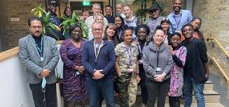
The Aims of Southwark Comes Together
Southwark Stands Together (SST) is a long-term programme of positive action, education and initiatives for the council to work in solidarity with Southwark’s communities and the council’s staff to tackle racism, injustice and inequality
Underpinned by our Fairer future values:
Always work to make Southwark more equal and just
Stand against all forms of discrimination and racism.
Work streams: employment and business; education; health; culture; communities; interaction with police; renewing and reinventing the public realm and council staff engagement

Slide 5
The Objectives of Southwark Comes Together - Workforce
We will create a culture where everyone can be themselves at work and are supported to achieve their full potential. We will ensure that our workforce is representative of the communities we serve with people who are committed to living our council values.

Slide 6
The Council’s Response With it’s Workforce
Listening Circles
Solutions Conversations
The development of Southwark Stands Together - Workforce
Wellbeing Survey

Slide 7
The Eight Workforce Workstream Objectives
Engagement
To ensure the workforce is fully engaged in the work stream and is supported by delivering a range of anti-racist development strategies and tools to challenge and alter behaviour in accordance with council values
Culture Change
To ensure that the workforce (excluding leaders and managers) are engaged with the council values and are held to account for behaviours
Leadership & Management
To ensure that leaders and managers are aware of their responsibilities in relation to E&D by embedding our council values and are held to account
Policies And Practices
To ensure that all related polices are audited, reviewed and updated in line with best practice to support delivery of the work stream

Slide 8
The Workforce Workstream Eight Objectives
Corporate Training Programmes
To ensure that the council offers a suite of interactive E&D training that is compliant with legislation and that the workforce is appropriately trained
Recruitment Practices
To explore and make changes to formal and informal recruitment practices to embed contemporary E&D solutions to improve senior management representation of black, Asian and ethnic minority employees across the workforce linked to cabinet targets
Career Progression
To explore barriers to career progression by understanding the lived experience of black, Asian and ethnic minority employees by creating and implementing innovative solutions to effect positive change
Employee Experience
To review employees’ experience from attraction to exit to identify any barriers and inform the redesign of policies and practices to improve the ability of staff to learn, grow and reach their full potential

Slide 9
What we’ve done
Project Management Office
Black on Board
Focus Groups
Focus Groups
Staff Listening Circles
Staff Listening Circles
Positive Action Lunch & Learn Sessions
Positive Action Lunch & Learn Sessions
Champions & Allies Network
Staff Wellbeing Plan
Staff Wellbeing Plan
Reciprocal Mentoring
Job Shadowing
Solutions Conversations
Revised Family Friendly Policies
EDI Training
Revised Family Friendly Policies
Changes to Recruitment Practices
Staff Wellbeing Toolkit
Internal and External Apprenticeships
Engagement Events
Revised Performance Development Framework
Stakeholder Recruitment Panels
Ethnicity Pay Gap
Revised Induction

Slide 10
What we still need to do
What we still want to do….
Improve our use of Data
Safe Spaces
Targets & Monitoring
EDI Leadership Training
Refresh our Communications
De-weaponise the Race Conversation
Revise HR Policies
360 Feedback for Managers
Shared Learning for Workforce Leads
Benchmarking
EDI Training
Process for Acting up & Honorariums
Employee Value Proposition
External Secondment Opportunities
Corporate Oversight
Positive Action
Training
Investigation Training
Ethnicity Pay Gap Strategy

